Slide 1
MORTGAGE VALUATION
Via regression modeling
on king county data set
Group 19
Alex Muturi Angela Nyaga
Annette Kalekye Chris Otieno

Slide 2
INTRODUCTION
We have analyzed King County House sales data to advise pricing decisions to be made by Mipaka, a real estate company.
Exploratory data analysis gave us insights into the data from which we derived price determinants using various modeling techniques.
From this we are able to get three main business recommendations.

Slide 3
Business problem
PRICING CHALLENGES
Mortgage valuation as is currently practiced doesn’t take into advantage the wealth of data that currently exists
CUSTOMERS
There is a need to attract the best buyers through competitive pricing that focuses on the factors that a customer is most interested in
FINANCIALS
Regression models accurately predict house values to optimize Mipaka’s pricing strategies to maximize profits

Slide 4
DATA UNDERSTANDING
King County House Sales dataset
The datasets contains valuable variables such as
price,
square feet covered by living room,
year of construction,
number of bathrooms,
conditions of the house
TARGET VARIABLE
the price, it serves as the independent variable in our modeling, we determine what influences house pricing

Slide 5
Business stakeholder
MIPAKA
is a fictional company in the real estate field.
They specialize in mortgage evaluation they also assess property values to determine risk for market lenders.

Slide 6



MODELS
Sq. ft of the living room explains 49% of variance in price
Considered age of building, living room and number of bathrooms
Grade of house as categorical variable
Model I
Model II
Model III

Slide 7

MODELS
Model IV
Condition of the house explains 64.0% of variance in price
RMSE is 220,298.52, slightly lower than Model III
p-value is below 0.05
Insights:
cost of a house increases by $124.90 for 1 square foot increase in living space
the cost of a house increases by $56,230 for each extra bathroom

Slide 8

MODELS
Model V
Sale price and location of the house (based on latitude and longitude)
Locations at centre of country have different prices
Prediction:
Built two KRegressor models to predict houses based on location
k=25 and k = 1000

Slide 9
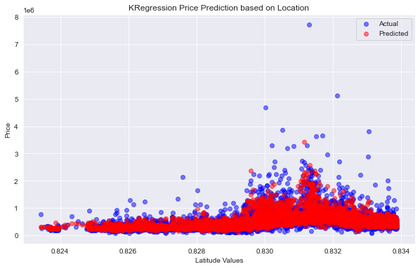
Prediction model 1
Kregression Price Prediction based on Location
OBSERVATIONS
PLOT
Kregression model k = 25
RMSE is 236992.59

Slide 10
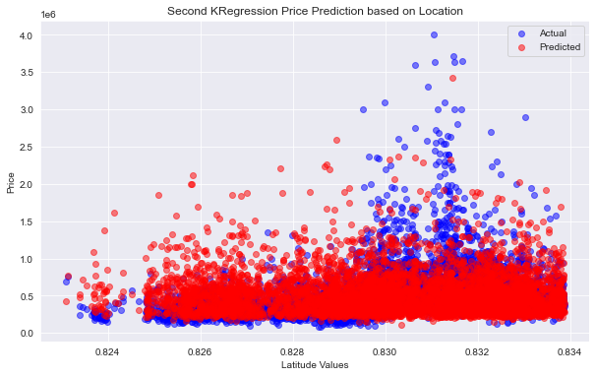
Prediction model 2
Kregression Price Prediction based on Location
OBSERVATIONS
PLOT
Kregression model k = 100
RMSE is 259889.70
Prediction price on first model is off by $ 236992.59
First model is predicting better than second model (RMSE is increasing with an increase in k-value)

Slide 11
Regression Results
IMPROVE ACCURACY
MAXIMUM RETURNS
Mipaka should consider the sq. ft of the living rooms, age, number of bathrooms, grade and condition to improve price prediction
These factors accounted for the most variance in change in prices
Mipaka should look to develop new housing developments on the Western Side of King County
Prices towards the East show a slight decrease in price, therefore being less likely to bring in profits
Note: Price prediction based on location is very sensitive to local variations

Slide 12


NEXT STEPS
EXPLORATORY DATA ANALYSIS
More EDA on factors that might affect house prices
Our best performing model accounted for less than 70% of the variance in sales
Further exploration should be done on factors not in the dataset that might affect house prices
DIRECT MARKET RESEARCH
Direct market research from real estate stakeholders
Direct feedback will enhance the models by providing key dimensions missing in the datasets

Slide 13
CONCULSION
This analysis equips Mipaka with data-driven insights and predictive modeling strategies to make strategic decisions in the competitive real estate industry. By focusing on popular ways to determine fair pricing using factors like sqft living, age, grade, condition to improve its profit maximization

